Slide 1


Slide 2
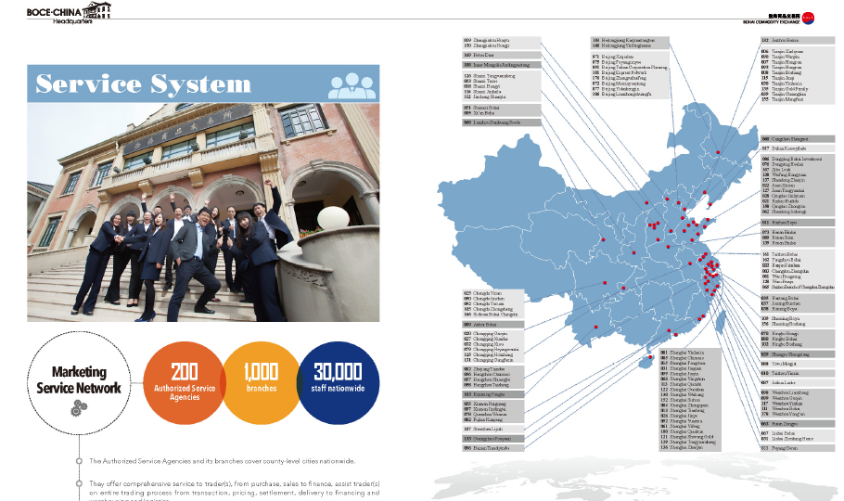

Slide 3
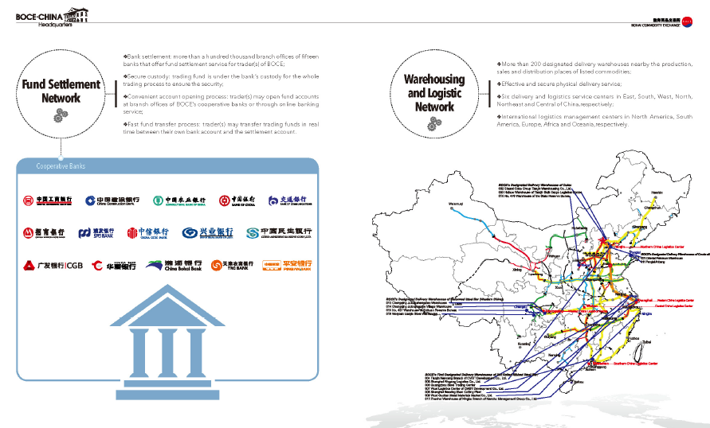

Slide 4
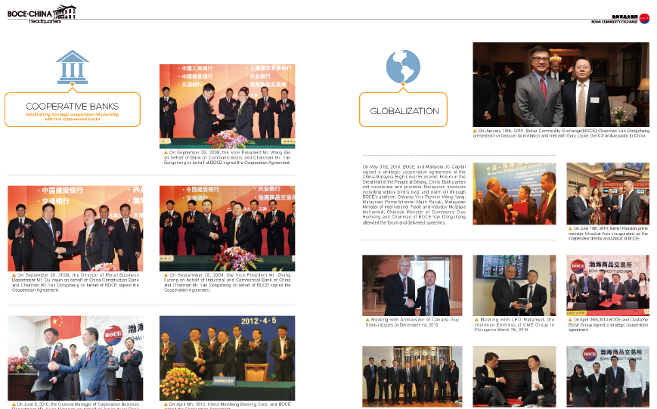

Slide 5
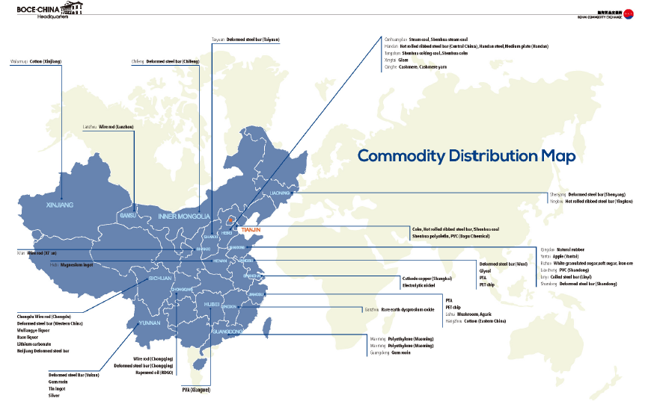

Slide 6
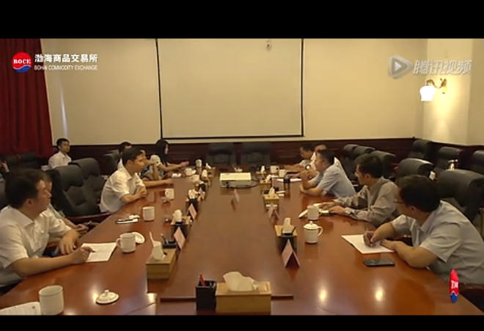
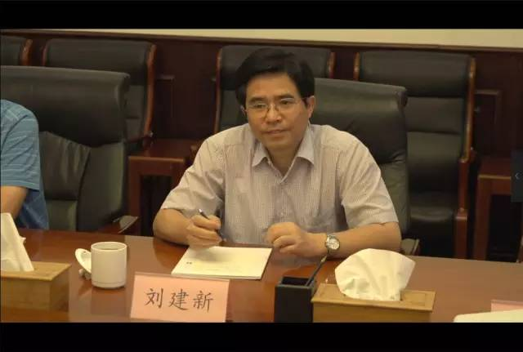
Latest Progress in July 2015
Zhuhai Mayor Jiang Ling led the delegation team and visited BOCE. Yan Dongsheng, the chairman of BOCE, appreciates the support given to the South China International Trade Center. BOCE will continue to accelerate "P2C" industry electricity supplier new model.
Liu Jianxin, vice mayor of Yichang City, encourages the development model from BOCE. He endorses and echoes a lot of collaboration opportunities between Yichang and BOCE. Further development will be planned by both sides.

Slide 7
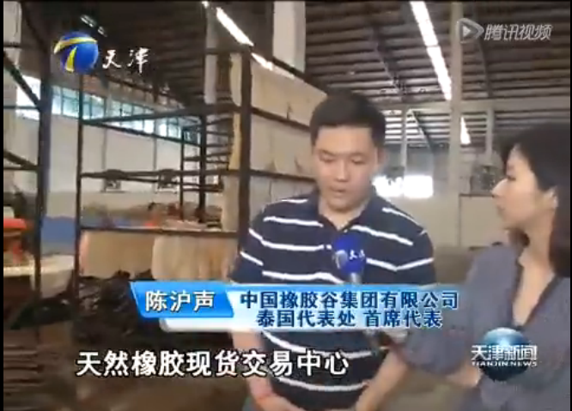
【一带一路看天津】 BOCE natural spot natural rubber trading center - built in rubber trade bridge between China and Thailand

Slide 8
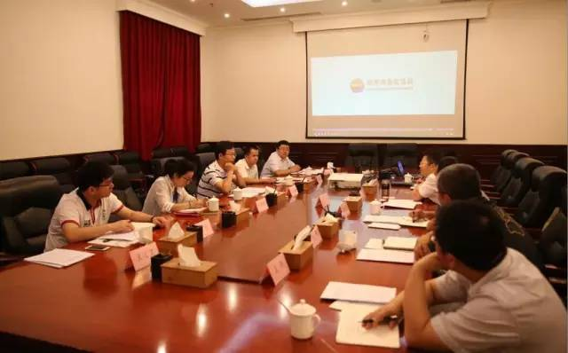
国家发改委“提升国际市场定价话语权”专题调研组来访渤商所
In July 2015, National Development and Reform Commission visited BOCE regarding to “increasing global market pricing power”

Slide 9
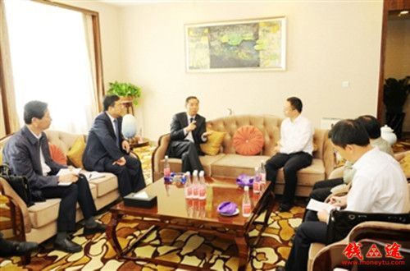
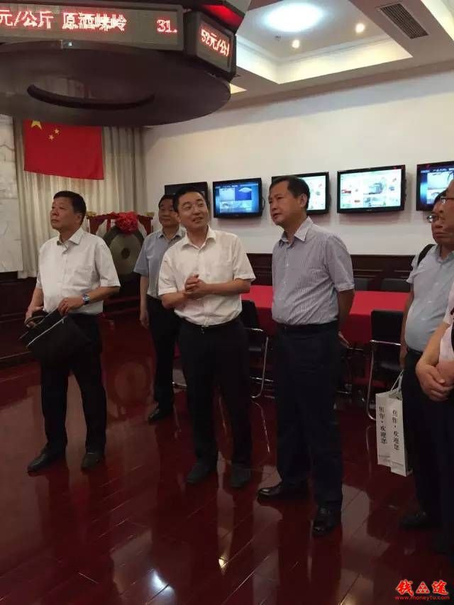
7月10日，在2015世界钾盐钾肥大会期间，青海省副省长、州委书记辛国斌会见了渤海商品交易所总经理助理周家宇一行，就电子商务平台建设进行沟通和交流
7月9日，焦作市委常委、常务副市长姜继鼎一行莅临渤海商品交易所（以下简称渤商所）考察访问，与渤商所有关负责人就如何利用P2C(Producer to Consumer)产业电商模式服务焦作经济转型发展进行了探讨与交流。
On July 10, 2015 during the World Conference of potash, vice governor of Qinghai, met with assistant general manager Zhou Jiayu of Bohai Commodity Exchange. It is going to leverage global business platform to increase global trade
Jiaozuo vice mayor visited BOCE and discussed the leverage P2C to help transformation of Jiaozuo’s economy

Slide 10
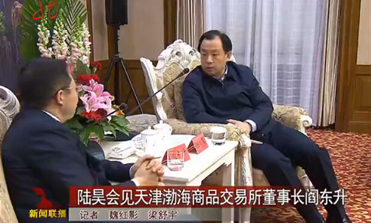

Growing outreach in China
We are enabling more
connections and business
operation
in north east China
We work 7x24x365 to
enable global business

Slide 11
Thank you 谢谢！

